Slide 1
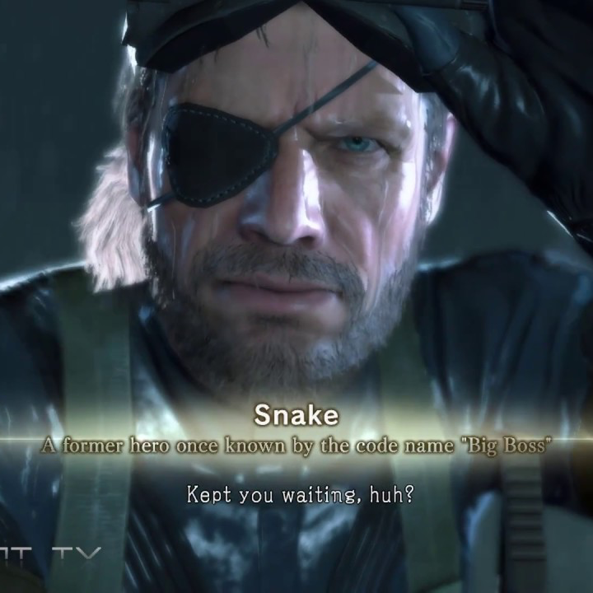
Computational Intelligence
01URROV — 2023/24

Slide 2
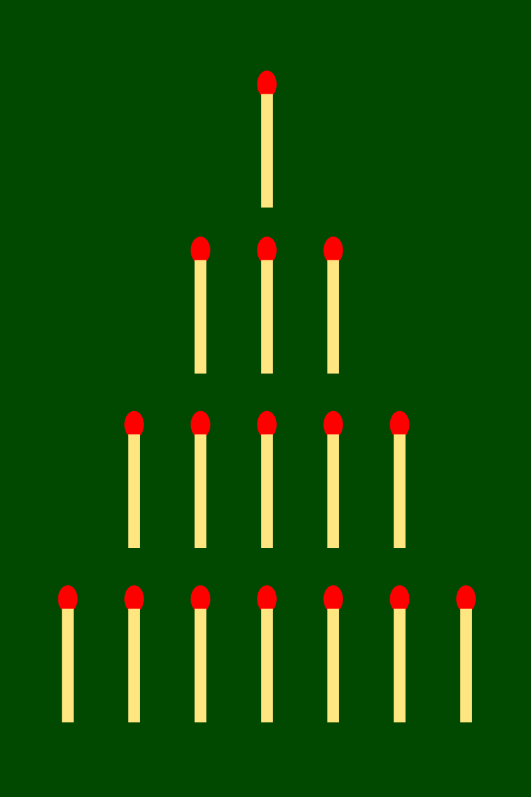
Nim
2 players' game
As many rows of matches as you want
As many matches as you want
Each turn: take [1, k] elements
You can find it on Dropbox (lab2- n.ipynb)

Slide 3
Nim agents
Rule-based agent
Nim-sum based
Row length in binary
Xor all rows
To win, nim sum shall always be != 0

Slide 4
Nim agents
2) Evolved agent
Nim-sum?
Evolution is the answer
ES
“+”, “,” strategis
Required: Gaussian mutation
Rules = operations?

Slide 5
Peer review!
Through GitHub Issues
Open a repository
Go to the tab “Issues”
New issue
Objective: 2 reviews per person
Remember to put them in the final report
Both done and received

Slide 6
Deadline
Lab: 13/11 h23:59 AOE
Peer review: 20/11 h23:59 AOE

Slide 7
